Slide 1



city of lomita
1st quarter
Law Enforcement Update
2025

Slide 2
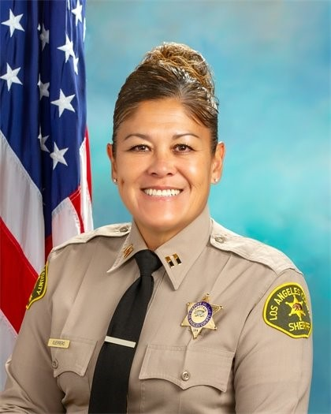

PRESENTED BY
CAPTAIN KIMBERLY GUERRERO LOMITA STATION

Slide 3

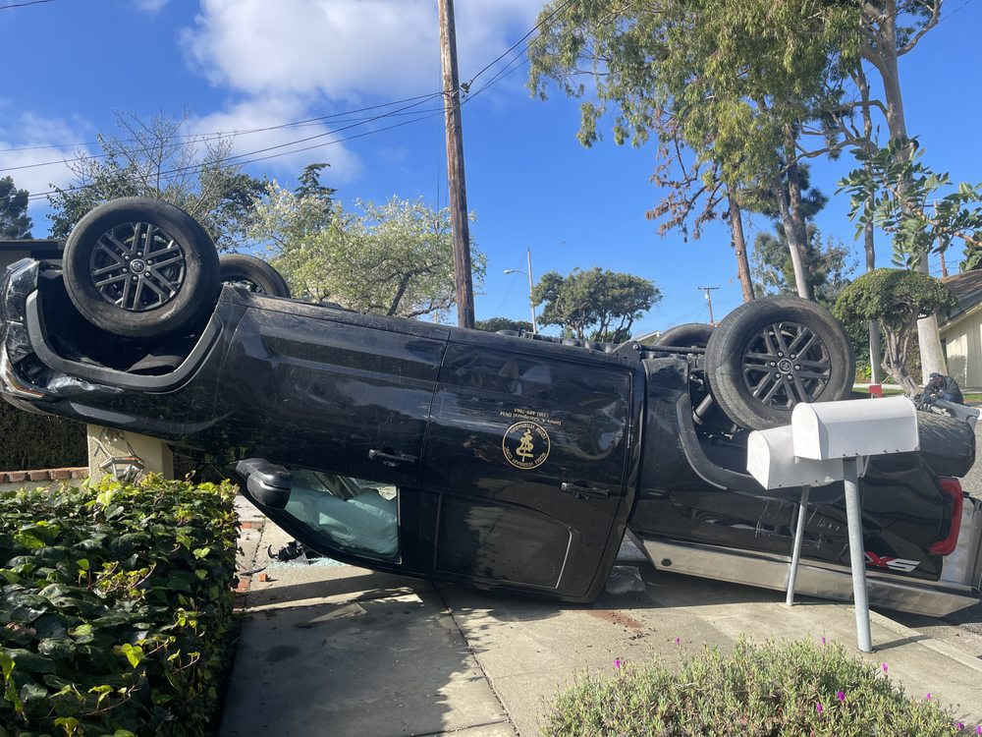

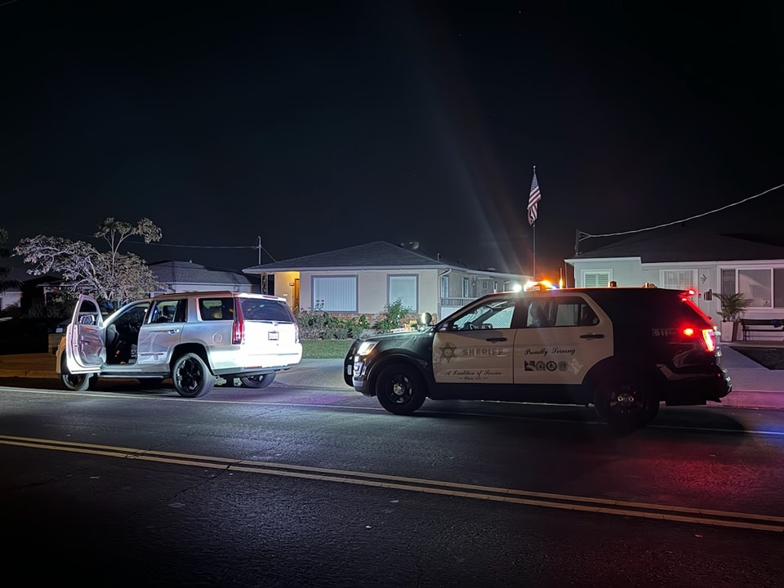
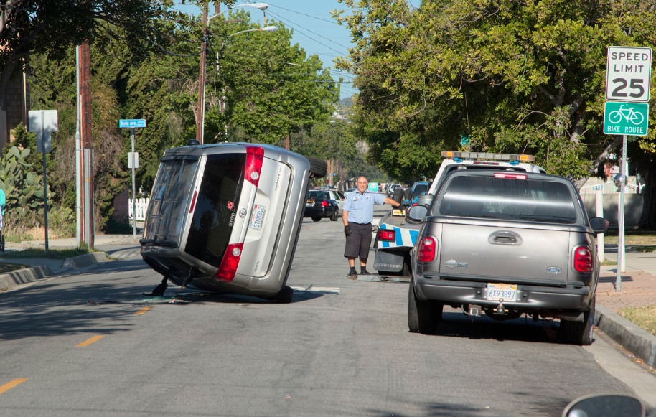
TRAFFIC

Slide 4

LOMITA
Traffic Stats
 |  | 2023 |  |  |  | 2024 |  |  |  | 2025
 |  | JAN | FEB | MAR | Average | JAN | FEB | MAR | Average | JAN | FEB | MAR | Average
Total Collisions |  | 10 | 12 | 24 | 15 | 13 | 10 | 17 | 13 | 13 | 10 | 16 | 13
Injury Collisions |  | 4 | 5 | 11 | 7 | 7 | 4 | 4 | 5 | 5 | 4 | 6 | 5
Enforcement Index |  | 19 | 15 | 3 | 12 | 9 | 21 | 11 | 14 | 4 | 3 | 4 | 4
Hazardous Cites |  | 74 | 75 | 30 | 60 | 63 | 82 | 41 | 62 | 20 | 11 | 22 | 18
Non-Haz Cites |  | 49 | 42 | 47 | 46 | 60 | 49 | 44 | 51 | 21 | 29 | 23 | 24
Parking Cites |  | 46 | 36 | 37 | 40 | 3 | 69 | 55 | 42 | 9 | 11 | 15 | 12
DUI Arrests |  | 1 | 1 | 1 | 1 | 3 | 2 | 3 | 3 | 2 | 1 | 0 | 1
DUI Collisions |  | 0 | 0 | 1 | 0 | 0 | 1 | 1 | 1 | 2 | 1 | 0 | 1
Fatal Collisions |  | 0 | 0 | 0 | 0 | 0 | 0 | 0 | 0 | 0 | 0 | 0 | 0
*Traffic Enforcement Index: Haz.Cites + DUI Arrests / Fatal + Injury Collisions (20:1)
1st Quarter Comparison

Slide 5

2025 CRIME STATS
1st QUARTER

Slide 6

2025 PART I – 1st QUARTER COMPARISON
CITY OF LOMITA
 | 2025 | 2024 | 2023 | 2022 | 2021
Homicide | 0 | 0 | 0 | 0 | 0
Rape | 0 | 1 | 0 | 1 | 0
Robbery | 2 | 2 | 11 | 5 | 4
Aggravated Assault | 11 | 10 | 9 | 22 | 15
Burglary, Residence | 17 | 4 | 6 | 6 | 7
Burglary, Structure | 14 | 6 | 21 | 2 | 7
Vehicle Burglary | 12 | 8 | 6 | 11 | 7
Theft from Vehicle | 6 | 3 | 7 | 4 | 4
Other Larceny / Theft | 41 | 42 | 39 | 35 | 30
Grand Theft Auto | 22 | 23 | 11 | 23 | 15
Arson | 0 | 0 | 2 | 0 | 0
TOTAL | 125 | 99 | 112 | 109 | 89

Slide 7

City of Lomita

Slide 8

PART II CRIME ACTIVITY COMPARISON
City of Lomita 1st Quarter
 | 2025 | 2024 | 2023 | 2022 | 2021
Forgery | 2 | 2 | 6 | 3 | 1
Fraud/ID Theft | 10 | 8 | 21 | 20 | 21
Sex Offense, Felony | 2 | 1 | 1 | 3 | 0
Sex Offense, Misdemeanor | 2 | 0 | 1 | 0 | 1
Non-Aggravated Assault | 7 | 11 | 9 | 10 | 15
Weapon Laws | 5 | 3 | 7 | 4 | 9
Offenses Against Family | 1 | 0 | 4 | 1 | 1
Liquor Laws | 0 | 0 | 0 | 0 | 0
Drunk-Alcohol/Drugs | 0 | 2 | 2 | 2 | 0
Disorderly Conduct | 1 | 0 | 1 | 1 | 3
Vagrancy | 0 | 0 | 0 | 0 | 0
Gambling | 0 | 0 | 0 | 0 | 0
Drunk Driving-Vehicle/Boat | 6 | 3 | 10 | 3 | 5
Vandalism (Non-graffiti) | 16 | 23 | 14 | 19 | 18
Vandalism (Graffiti) | 0 | 5 | 2 | 1 | 0
Receiving Stolen Property | 0 | 0 | 1 | 0 | 0
Federal Offenses w/o money | 0 | 0 | 0 | 0 | 0
Federal Offenses w/ money | 0 | 0 | 0 | 0 | 0
Felonies, Misc | 0 | 3 | 5 | 4 | 11
Misdemeanors, Misc | 8 | 10 | 5 | 13 | 12
TOTAL CRIME | 60 | 71 | 89 | 84 | 97
ARRESTS
Part I | 34 | 19 | 23 | 21 | 23
Part II | 71 | 83 | 92 | 72 | 108
TOTAL ARRESTS | 105 | 102 | 115 | 93 | 131
Burglaries | 12 | 4 | 7 | 4 | 2
GTA's | 4 | 4 | 5 | 3 | 4
Narco | 18 | 34 | 16 | 6 | 8

Slide 9

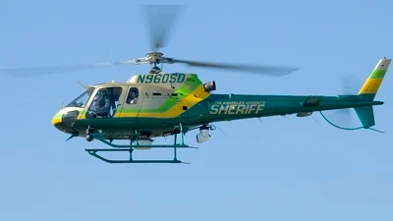
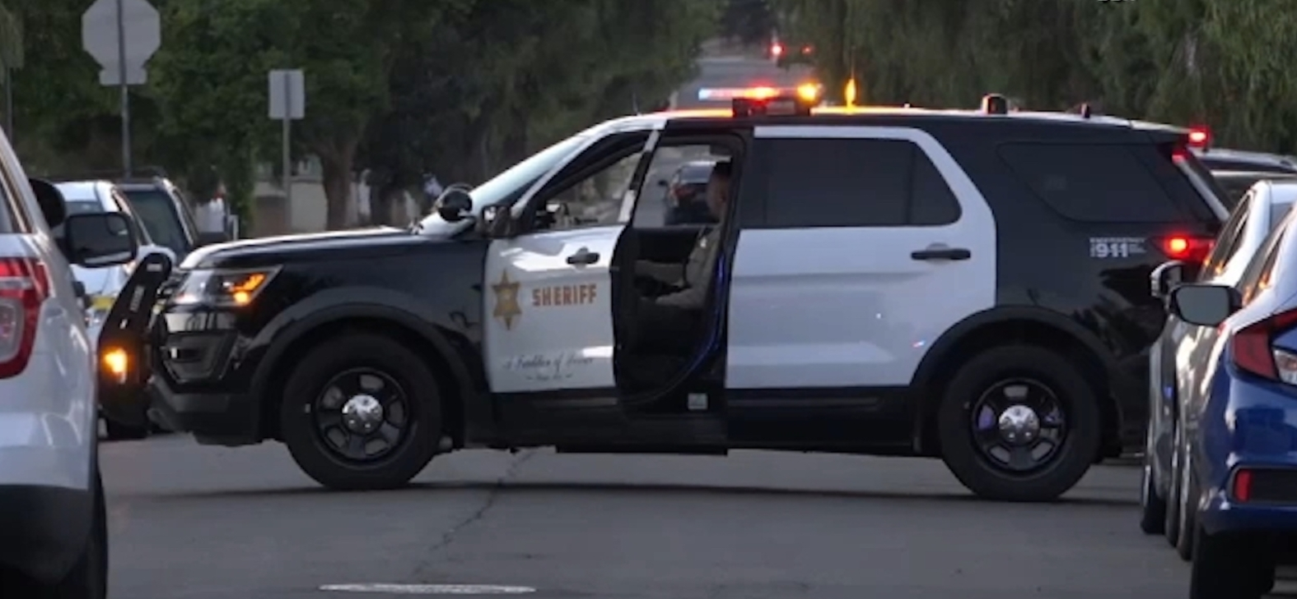
RESPONSE TIMES

Slide 10

City of Lomita
2025 First Quarter Average Response Times

Slide 11
CITY OF LOMITA EMERGENT CALL RESPONSE
1st Quarter 2025 Page 1
DATE | LOCATION | TYPE OF CALL | ENTRY | ENROUTE | ARRIVAL | RESP TIME MIN | TAG
01/02 | PV DR N/ROLLING VISTA DR | TRAFFIC COLLISIN | 0445 | 0446 | 0450 | 5 | 5
01/02 | PCH | DISTURBANCE | 1125 | 1126 | 1129 | 4 | 12
01/02 | 241ST STREET | ASSAULT W/WEAPON | 2239 | 2240 | 2247 | 8 | 32
01/02 | 241ST STREET | MEDICAL RESCUE | 2307 | 2308 | 2308 | 1 | 36
01/03 | ESHELMAN AV/LOMITA BL | MEDICAL RESCUE | 1540 | 1541 | 1548 | 8 | 25
01/04 | CRENSHAW BL/LOMITA BL | TRAFFIC COLLISIN | 0636 | 0637 | 627 | 1 | 16
01/04 | OAK ST | FAMILY DISTURBANCE | 1253 | 1254 | 1258 | 5 | 42
01/04 | LUCILLE AV/PCH | MEDICAL RESCUE | 2226 | 2227 | 2228 | 2 | 75
01/05 | 255TH STREET | BURGLARY TO RES | 0530 | 0531 | 532 | 2 | 13
01/05 | MCKENNA CT | MEDICAL RESCUE | 1953 | 1954 | 1956 | 3 | 66
01/07 | PCH | MEDICAL RESCUE | 0235 | 0236 | 237 | 2 | 11
01/07 | LOMITA BL | ASSAULT W/WEAPON | 1229 | 1230 | 1233 | 4 | 54
01/07 | 250TH ST/PENNSYLVANIA | MEDICAL RESCUE | 1302 | 1303 | 1306 | 4 | 57
01/07 | COMAL CT | BURGLARY TO RES | 2110 | 2111 | 2112 | 2 | 112
01/10 | PCH/NARBONNE AV | MEDICAL RESCUE | 1605 | 1606 | 1606 | 1 | 62
01/10 | PCH | GRAND THEFT | 1907 | 1907 | 1907 | 1 | 68
01/10 | OAK ST | FAMILY DISTURBANCE | 2130 | 2131 | 2135 | 5 | 81
01/12 | COLLISON ST | BURGLARY TO RES | 1949 | 1949 | 1949 | 1 | 55
01/13 | PCH | BURG TO BUSINESS | 2336 | 2337 | 2338 | 2 | 80
01/14 | NARBONNE | FIRE | 0437 | 0438 | 439 | 2 | 7
01/14 | WALNUT ST/LOMITA BL | TRAFFIC COLLISIN | 1427 | 1428 | 1429 | 2 | 37
01/14 | PCH | MEDICAL RESCUE | 1719 | 1720 | 1722 | 3 | 45
01/16 | PCH/ESHELMAN AT | ROBBERY | 1559 | 1600 | 1603 | 2 | 52
01/17 | 253RD ST | MEDICAL RESCUE | 0821 | 0822 | 824 | 3 | 16
01/18 | OAK ST | MEDICAL RESCUE | 1317 | 1318 | 1321 | 4 | 33
01/18 | PCH | DISTURBANCE | 1942 | 1943 | 1947 | 5 | 48
01/19 | PCH | MEDICAL RESCUE | 0903 | 0904 | 905 | 2 | 17
01/19 | 255TH STREET | DISTURBANCE | 1411 | 1412 | 1414 | 3 | 31

Slide 12
CITY OF LOMITA EMERGENT CALL RESPONSE
1st Quarter 2025 Page 2
DATE | LOCATION | TYPE OF CALL | ENTRY | ENROUTE | ARRIVAL | RESP TIME MIN | TAG
01/19 | ANDREO AV | DISTURBANCE | 2117 | 2118 | 2121 | 4 | 53
01/19 | PV DR N/WESTERN AV | TRAFFIC COLLISIN | 2119 | 2120 | 2122 | 3 | 54
01/19 | 247TH STREET | ASSAULT | 2152 | 2153 | 2156 | 4 | 56
01/19 | 247TH STREET | ASSAULT | 2334 | 2335 | 2338 | 4 | 64
01/20 | 247TH STREET | ASSAULT | 0746 | 0747 | 749 | 3 | 17
01/20 | OAK ST | ASSAULT | 1241 | 1242 | 1244 | 3 | 34
01/21 | LOMITA BL/WOODWARD AV | MEDICAL RESCUE | 1307 | 1308 | 1310 | 3 | 33
01/22 | HALLWORTH AV | BURGLARY TO RES | 1837 | 1838 | 1840 | 3 | 62
01/23 | 257TH ST/WALNUT ST | MEDICAL RESCUE | 1605 | 1606 | 1610 | 5 | 77
01/23 | 247TH STREET | MEDICAL RESCUE | 1851 | 1852 | 1855 | 3 | 89
01/24 | PCH | MEDICAL RESCUE | 1439 | 1440 | 1445 | 6 | 63
01/24 | PCH | DISTURBANCE | 2131 | 2132 | 2132 | 1 | 101
01/24 | ALLIENE AV/LOMITA BL | TRAFFIC COLLISIN | 2143 | 2144 | 2147 | 4 | 103
01/24 | NARBONNE AV | DISTURBANCE | 2253 | 2254 | 2256 | 3 | 110
01/25 | LOMITA BL | DISTURBANCE | 0221 | 0222 | 226 | 5 | 7
01/25 | 257TH ST/WALNUT ST | MEDICAL RESCUE | 0941 | 0942 | 943 | 2 | 28
01/25 | PENNSYLVANIA AV | MEDICAL RESCUE | 1836 | 1837 | 1840 | 4 | 74
01/26 | PCH | BURGLARY TO RES | 1546 | 1547 | 1547 | 1 | 38
01/27 | NARBONNE AV | TRAFFIC COLLISIN | 0039 | 0040 | 43 | 4 | 3
01/29 | ESHELMAN AV | STOLEN VEHICLE | 0532 | 0533 | 0535 | 3 | 12
01/30 | PCH | BURG TO BUSINESS | 0759 | 0800 | 0801 | 2 | 18
01/30 | WALNUT AV | DISTURBANCE | 2034 | 2035 | 2037 | 4 | 64
01/31 | CYPRESS ST/PCH | TRAFFIC COLLISIN | 1001 | 1002 | 1005 | 4 | 29
01/31 | ESHELMAN AV | BATTERY | 1812 | 1813 | 1815 | 3 | 69
02/01 | PCH | MEDICAL RESCUE | 0628 | 0629 | 0630 | 2 | 24
02/02 | OAK ST | MEDICAL RESCUE | 0728 | 0729 | 0729 | 1 | 18
02/02 | PCH | BURG TO BUSINESS | 2118 | 2119 | 2119 | 1 | 69
02/04 | PCH/PENNSYLVANIA AV | MEDICAL RESCUE | 1128 | 1129 | 1129 | 1 | 33

Slide 13
CITY OF LOMITA EMERGENT CALL RESPONSE
1st Quarter 2025 Page 3
DATE | LOCATION | TYPE OF CALL | ENTRY | ENROUTE | ARRIVAL | RESP TIME MIN | TAG
02/04 | NARBONNE AV | MEDICAL RESCUE | 1319 | 1320 | 1322 | 3 | 40
02/04 | PCH | VANDALISM | 1631 | 1632 | 1633 | 2 | 59
02/05 | OAK ST | FAMILY DISTURBANCE | 0240 | 0241 | 0241 | 1 | 5
02/06 | ESHELMAN AV | MEDICAL RESCUE | 0135 | 0136 | 0138 | 3 | 5
02/07 | PCH/ESHELMAN AV | FIRE | 1344 | 1345 | 1345 | 1 | 48
02/07 | 264TH STREET | BURGLARY TO RES | 2327 | 2328 | 2330 | 3 | 106
02/08 | PCH | PETTY THEFT | 1950 | 1951 | 1952 | 2 | 58
02/09 | LOMITA BL/WALNUT AV | MEDICAL RESCUE | 1519 | 1520 | 1521 | 2 | 28
02/09 | NARBONNE AV | TRAFFIC COLLISIN | 1639 | 1640 | 1641 | 2 | 33
02/09 | 249TH ST | FAMILY DISTURBANCE | 1842 | 1843 | 1845 | 3 | 39
02/10 | OAK ST | DISTURBANCE | 0130 | 0131 | 0132 | 2 | 3
02/10 | 241ST STREET | DISTURBANCE | 0924 | 0925 | 0922 | 9 | 27
02/11 | ESHELMAN AV/LOMITA BL | MEDICAL RESCUE | 1500 | 1501 | 1503 | 3 | 74
02/11 | 256TH STREET | BURGLARY TO RES | 2106 | 2114 | 2106 | 8 | 94
02/13 | OAK ST | MEDICAL RESCUE | 2012 | 2013 | 2015 | 3 | 77
02/14 | CYPRESS ST | SUSPICIOUS PERSON | 1418 | 1419 | 1421 | 3 | 44
02/14 | WALNUT ST | SUSPICIOUS PERSON | 2333 | 2334 | 2336 | 3 | 93
02/16 | WALNUT ST | MEDICAL RESCUE | 0902 | 0903 | 0904 | 2 | 14
02/16 | 253RD ST | BURGLARY TO RES | 1624 | 1625 | 1628 | 4 | 47
02/17 | OAK ST | BATTERY | 1101 | 1102 | 1105 | 4 | 28
02/17 | OAK ST | BATTERY | 1101 | 1102 | 1102 | 1 | 29
02/17 | 262ND STREET | MEDICAL RESCUE | 1912 | 1912 | 1912 | 1 | 71
02/17 | PCH | BURG TO BUSINESS | 2059 | 2100 | 2103 | 4 | 74
02/18 | 256TH STREET | MEDICAL RESCUE | 1733 | 1734 | 1734 | 1 | 78
02/19 | PCH | BURG TO BUSINESS | 2027 | 2028 | 2029 | 2 | 81
02/21 | PCH | BURG TO BUSINESS | 0144 | 0145 | 0146 | 2 | 5
02/21 | WESTERN AVE | BURG TO BUSINESS | 0633 | 0633 | 0637 | 4 | 11
02/21 | LOMITA BLVD | MEDICAL RESCUE | 0753 | 0754 | 0755 | 2 | 18

Slide 14
CITY OF LOMITA EMERGENT CALL RESPONSE
1st Quarter 2025 Page 4
DATE | LOCATION | TYPE OF CALL | ENTRY | ENROUTE | ARRIVAL | RESP TIME MIN | TAG
02/21 | PCH/NARBONNE AV | TRAFFIC COLLISIN | 1400 | 1401 | 1401 | 1 | 56
02/21 | WALNUT ST | MEDICAL RESCUE | 1530 | 1531 | 1533 | 3 | 60
02/21 | VIANA AV | MEDICAL RESCUE | 1869 | 1867 | 1839 | 3 | 77
02/21 | ESHELMAN AV | WELFARE CHECK | 2121 | 2122 | 2124 | 3 | 86
02/22 | 246TH STREET | MEDICAL RESCUE | 2110 | 2111 | 2116 | 5 | 61
02/23 | ESHELMAN AVE | MEDICAL RESCUE | 0951 | 0952 | 0953 | 2 | 15
02/24 | 250TH ST/OAK ST | MEDICAL RESCUE | 0554 | 0555 | 0558 | 4 | 11
02/25 | OAK STREET | FAMILY DISTURBANCE | 1357 | 1358 | 1400 | 3 | 47
02/25 | PCH/ESHELMAN AV | MEDICAL RESCUE | 1434 | 1435 | 1436 | 2 | 48
02/25 | OAK STREET | FAMILY DISTURBANCE | 1532 | 1533 | 1535 | 3 | 51
02/26 | NARBONNE AVE | DISTURBANCE | 0057 | 0058 | 101 | 4 | 2
02/26 | 248TH STREET | FAMILY DISTURBANCE | 0305 | 0306 | 0306 | 1 | 7
02/26 | FALENA AV | MEDICAL RESCUE | 1739 | 1740 | 1745 | 4 | 85
02/26 | 245TH STREET | FAMILY DISTURBANCE | 2348 | 2349 | 2352 | 4 | 113
02/27 | WESTERN AV/CADDINGTON | TRAFFIC ACCIDENT | 1519 | 1520 | 1521 | 3 | 80
02/28 | OAK STREET | MEDICAL RESCUE | 0626 | 0627 | 0630 | 4 | 14
03/02 | NARBONNE AVE | BURGLARY TO RES | 0414 | 0142 | 0142 | 1 | 3
03/02 | 255TH ST/WOODWARD AV | ASSAULT | 2137 | 2138 | 2142 | 5 | 67
03/02 | PCH/WALNUT AV | FAMILY DISTURBANCE | 2230 | 2231 | 2233 | 2 | 71
03/03 | ESHELMAN AVE | TRAFFIC ACCIDENT | 1337 | 1338 | 1345 | 8 | 27
03/03 | PCH | BURG TO BUSINESS | 1623 | 1624 | 1625 | 2 | 46
03/04 | LOMITA BL/ESHELMAN AV | MEDICAL RESCUE | 0506 | 0507 | 0510 | 4 | 5
03/04 | PCH/NARBONNE AV | FAMILY DISTURBANCE | 1201 | 1202 | 1204 | 3 | 24
03/04 | LOMITA BLVD | MEDICAL RESCUE | 1626 | 1627 | 1631 | 5 | 43
03/04 | NARBONNE AV | FAMILY DISTURBANCE | 2037 | 2038 | 2040 | 3 | 51
03/05 | 255TH STREET | FAMILY DISTURBANCE | 0249 | 0250 | 0257 | 5 | 8
03/05 | ESHELMAN AVE | MEDICAL RESCUE | 1938 | 1939 | 1942 | 4 | 88
03/06 | WESTERN AV/PV DR N | FAMILY DISTURBANCE | 0102 | 0103 | 0104 | 2 | 2

Slide 15
CITY OF LOMITA EMERGENT CALL RESPONSE
1st Quarter 2025 Page 5
DATE | LOCATION | TYPE OF CALL | ENTRY | ENROUTE | ARRIVAL | RESP TIME MIN | TAG
03/06 | 250TH STREET | BURGLARY TO RES | 2140 | 2141 | 2144 | 4 | 76
03/09 | LOMITA BLVD | ROBBERY TO BUS | 1938 | 1939 | 1941 | 3 | 73
03/10 | ELEANOR PL | BURGLARY TO RES | 1537 | 1538 | 1542 | 5 | 52
03/10 | PCH/ESHELMAN AV | MEDICAL RESCUE | 1611 | 1612 | 1612 | 1 | 56
03/11 | PCH | DISTURBANCE | 1218 | 1219 | 1220 | 2 | 41
03/11 | 258TH PLACE | BURGLARY TO RES | 1346 | 1347 | 1349 | 3 | 51
03/12 | NARBONNE AV/LOMITA BL | SPOUSAL ASSAULT | 0214 | 0215 | 0217 | 3 | 11
03/12 | NARBONNE AVE | TRAFFIC ACCIDENT | 0753 | 0754 | 0756 | 3 | 27
03/12 | NARBONNE AVE | FAMILY DISTURBANCE | 2157 | 2158 | 2200 | 3 | 93
03/13 | NARBONNE AVE | TRAFFIC ACCIDENT | 0903 | 0904 | 0906 | 3 | 26
03/13 | PCH/ESHELMAN AVE | TRAFFIC ACCIDENT | 1212 | 1213 | 1213 | 1 | 43
03/15 | NARBONNE AVE/PCH | TRAFFIC ACCIDENT | 1512 | 1513 | 1514 | 2 | 50
03/16 | APPIAN WAY/PCH | MEDICAL RESCUE | 0939 | 0940 | 0943 | 4 | 25
03/17 | ESHELMAN AVE | TRAFFIC ACCIDENT | 0120 | 0123 | 0128 | 8 | 3
03/17 | FEIJOA AV | MEDICAL RESCUE | 1009 | 1010 | 1017 | 8 | 26
03/19 | LOMITA BLVD | FAMILY DISTURBANCE | 0411 | 0412 | 0417 | 6 | 13
03/19 | VIANNA AV | FAMILY DISTURBANCE | 2044 | 2045 | 2048 | 4 | 85
03/22 | NARBONNE AVE | BURGLARY TO RES | 1443 | 1444 | 1444 | 1 | 60
03/23 | PCH/NARBONNE AV | TRAFFIC ACCIDENT | 1050 | 1051 | 1052 | 2 | 42
03/23 | NARBONNE AVE | MEDICAL RESCUE | 1937 | 1938 | 1939 | 2 | 70
03/24 | NARBONNE AVE | BURG TO BUSINESS | 1325 | 1326 | 1328 | 3 | 31
03/24 | 252ND/ESHELMAN AV | MEDICAL RESCUE | 1443 | 1444 | 1445 | 2 | 48
03/24 | NARBONNE AVE | FAMILY DISTURBANCE | 1846 | 1847 | 1911 | 9 | 70
03/24 | NARBONNE AVE | BURG TO BUSINESS | 2344 | 2345 | 2345 | 1 | 93
03/25 | 259TH PLACE | MEDICAL RESCUE | 1212 | 1213 | 1216 | 4 | 37
03/26 | PENNSYLVANIA AV/HILLVIEW LN | TRAFFIC ACCIDENT | 2304 | 2305 | 2306 | 2 | 110
03/27 | 263RD STREET | MEDICAL RESCUE | 1320 | 1321 | 1323 | 3 | 53
03/27 | 257TH STREET | FAMILY DISTURBANCE | 1828 | 1829 | 1831 | 3 | 70

Slide 16
CITY OF LOMITA EMERGENT CALL RESPONSE
1st Quarter 2025 Page 6
DATE | LOCATION | TYPE OF CALL | ENTRY | ENROUTE | ARRIVAL | RESP TIME MIN | TAG
03/27 | ESHELMAN AVE | FIGHT DISTURBANCE | 2108 | 2109 | 2113 | 5 | 84
03/28 | LOMITA BL | SUSPICIOUS PERSON | 1506 | 1507 | 1511 | 5 | 57
03/28 | LOMITA BL | POSS CAR JACKING | 2346 | 2346 | 2346 | 0 | 80
03/29 | 256TH STREET | BURGLARY TO RES | 1427 | 1428 | 1431 | 4 | 40
03/31 | BLAND PLACE | TRAFFIC ACCIDENT | 1902 | 1903 | 1905 | 3 | 80
04/02 | BECKNEL AVE | MEDICAL RESCUE | 1858 | 1859 | 1904 | 6 | 96
04/04 | CRENSHAW BL/LOMITA BL | FIRE | 1439 | 1440 | 1443 | 3 | 46
04/05 | NARBONNE AV/PCH | FIRE | 0757 | 0758 | 0759 | 2 | 15
04/05 | PCH/PENNSYLVANIA AV | FIRE | 0810 | 0811 | 0814 | 4 | 16
04/05 | LOMITA BLVD | BURG TO BUSINESS | 2245 | 2246 | 2247 | 2 | 66
04/06 | NARBONNE AVE | SPOUSAL ASSAULT | 1546 | 1547 | 1547 | 1 | 51
04/07 | NORDMAN STREET | MEDICAL RESCUE | 1306 | 1307 | 1309 | 3 | 38
04/07 | BANI AVE | BURGLARY TO RES | 1952 | 1953 | 1954 | 2 | 72
04/07 | LOMITA BLVD | VANDALISM | 2024 | 2025 | 2029 | 5 | 75
04/08 | LOMITA BL/NARBONNE AV | TRAFFIC ACCIDENT | 1743 | 1744 | 1747 | 4 | 65
04/10 | NARBONNE AVE | FAMILY DISTURBANCE | 2128 | 2129 | 2130 | 2 | 91
04/12 | 263RD ST/ALTA VISTA AV | BURGLARY TO RES | 1005 | 1006 | 1010 | 5 | 28
04/12 | PCH | MEDICAL RESCUE | 1253 | 1254 | 1256 | 3 | 39
04/12 | 249TH STREET | MEDICAL RESCUE | 1649 | 1650 | 1652 | 3 | 60
04/12 | LOMITA BLVD | TRAFFIC ACCIDENT | 1812 | 1813 | 1814 | 2 | 64
04/12 | 247TH STREET | MEDICAL RESCUE | 1849 | 1850 | 1852 | 3 | 68
04/13 | 253RD STREET | MEDICAL RESCUE | 1639 | 1640 | 1642 | 2 | 52
04/15 | LOMITA BLVD | TRAFFIC ACCIDENT | 0610 | 0611 | 0613 | 3 | 15
04/15 | PV DR EAST | MEDICAL RESCUE | 1230 | 1231 | 1231 | 1 | 46
04/15 | PCH | SPOUSAL ASSAULT | 2146 | 2147 | 2148 | 2 | 98
04/16 | NARBONNE AVE | FIGHT DISTURBANCE | 1444 | 1444 | 1444 | 1 | 68
04/16 | NARBONNE AVE | TRAFFIC ACCIDENT | 1642 | 1643 | 1643 | 1 | 80
04/16 | PCH | MEDICAL RESCUE | 1704 | 1705 | 1709 | 5 | 83

Slide 17
CITY OF LOMITA EMERGENT CALL RESPONSE
1st Quarter 2025 Page 7
DATE | LOCATION | TYPE OF CALL | ENTRY | ENROUTE | ARRIVAL | RESP TIME MIN | TAG
04/17 | PCH | FIRE | 1502 | 1503 | 1505 | 3 | 64
04/19 | OAK STREET | SPOUSAL ASSAULT | 0945 | 0946 | 0946 | 1 | 24
04/19 | LOMITA BL | SUSPICIOUS PERSON | 0946 | 0947 | 0952 | 6 | 25
04/19 | NARBONNE AVE | TRAFFIC ACCIDENT | 1540 | 1541 | 1542 | 2 | 47
04/21 | LOMITA BL/WALNUT AV | TRAFFIC ACCIDENT | 2342 | 2343 | 2344 | 2 | 85
04/22 | PCH | MEDICAL RESCUE | 1129 | 1130 | 1131 | 2 | 45
04/23 | PCH | TRAFFIC ACCIDENT | 1442 | 1423 | 1445 | 3 | 48
04/25 | 256TH ST/OAK ST | TRAFFIC ACCIDENT | 0804 | 0804 | 0808 | 4 | 26
04/25 | ESHELMAN AVE | STOLEN VEHICLE | 1342 | 1343 | 1344 | 2 | 48
04/26 | PCH | ROBBERY | 0024 | 0025 | 0026 | 2 | 3
04/26 | CYPRESS ST/PCH | SPOUSAL ASSAULT | 1521 | 1522 | 1523 | 2 | 46
04/27 | NARBONNE AVE | BURG TO BUSINESS | 1004 | 1005 | 1008 | 4 | 33
04/29 | 250TH ST/PENNSYLVANIA | TRAFFIC ACCIDENT | 1648 | 1649 | 1652 | 4 | 84

Slide 18
